Slide 1
SI206 Discussion 8
API & JSON

Slide 2
Objective
The purpose of today’s section is to get familiar with API and JSON.
Create an API request
Get familiar with JSON viewer
Understand the difference between JSON format and python format
Analyze nested data
Debugging

Slide 3
Understand the difference between JSON format and python format
url = “https://api.sunrise-sunset.org/json? lat=36.7201600&lng=-4.4203400&date=today"
data1 | = | requests.get(url) | # | receive | response
data2 | = | data1.text | # | request | -> JSON object
data3 | = | json.loads(data2) | # | JSON -> | Python object
data4 = json.dumps(data3) # Python -> JSON object
data2 and data4 are identical
You need to paste data2 or data4 to JSON Online Editor

Slide 4
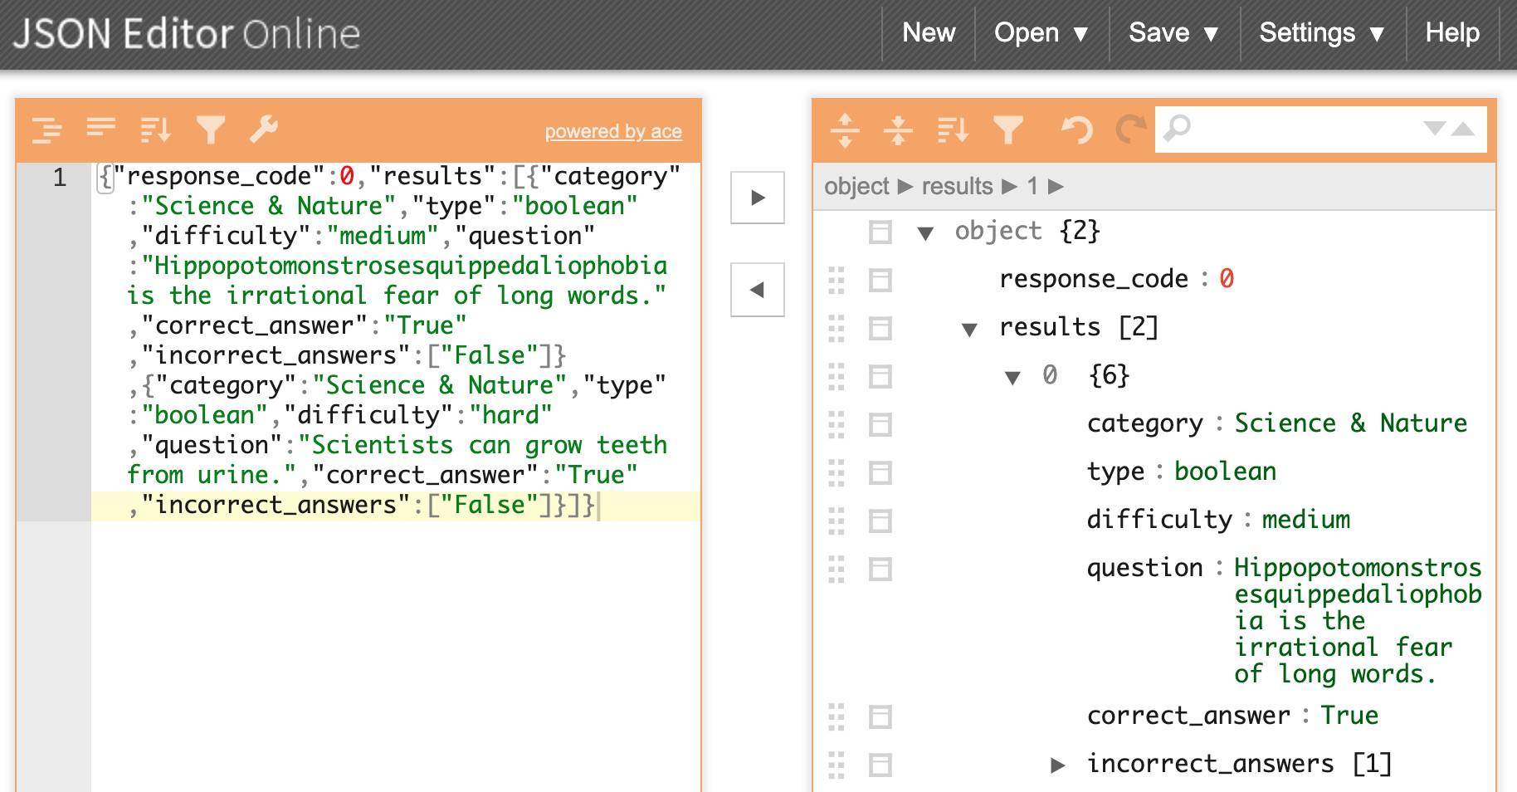
JSON Editor Online : https://jsoneditoronline.org/#left=local.vigeci&right=local.sinece
^{Google "JSON editor online"}
Just copy and paste JSON format strings.

Slide 5
Today’s Task (more detail in starter code)
Use the World Bank API and get population for different countries
Demo:
Write a function get_population(country_code, date) that takes a country code (e.g. USA, BRA) and a date in years (e.g. 2017) that returns the value as an integer.
TASK 1:
Write a function get_data(country_code, first_year, second_year) that takes a country code (e.g. USA, BRA) and two consecutive years (e.g. 2004 and 2005) that returns the data from the API after converting it to a python list.
TASK 2:
Write a function population_growth(country_code, first_year, second_year) that calls get_data(country_code, first_year, second_year) and returns the population growth of the country for the two years in a tuple.

Slide 6
DEMO
Walking through how to solve get_gdp()

Slide 7
How to go about TASK 1?
Read documentation for World Bank API https://datahelpdesk.worldbank.org/knowledgebase/articles/898581
What is the base URL of the World Bank API?
What is the code for population information? (Scroll to "Featured Indicators” on the page below)
http://datatopics.worldbank.org/world-development-indicators/themes/people.html
How should the parameters about gdp, country, and year be combined with the base URL?

